Slide 1



Bridging the Energy Gap: A Data-Driven Approach to Sustainable Development
This pitch deck presents a comprehensive data-driven approach to address the energy access disparity and promote renewable energy adoption, aligning with Sustainable Development Goal (SDG) 7.
by frankline omari

Slide 2


Sustainable Development Goal 7: Affordable and Clean Energy
1
Energy Access
Ensuring access to affordable, reliable, sustainable and modern energy for all.
2
Renewable Energy
Substantially increasing the share of renewable energy in the global energy mix.
3
Energy Efficiency
Improving energy efficiency significantly in all sectors.

Slide 3
Defining the Problem
Energy Access Disparity
Renewable Energy Adoption
Millions lack access to electricity, hindering economic development, education, and healthcare.
The transition to renewable energy faces challenges, such as initial cost, regulatory hurdles, and technological limitations.

Slide 4


Problem Significance
1
Economic Inequality
Energy poverty perpetuates a cycle of poverty and limits economic growth.
2
Environmental Degradation
Overreliance on fossil fuels contributes to climate change and environmental pollution.
3
Social Injustice
Energy access disparities exacerbate existing inequalities and hinder social progress.

Slide 5
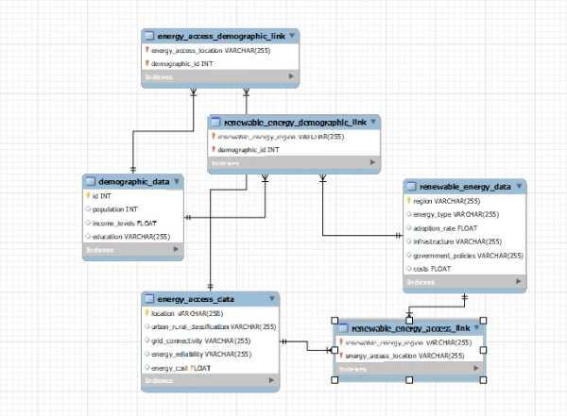
Database Design: Understanding the Landscape
Entity-Relationship Diagram (ERD)
Key Entities
demographic_data: This table stores basic demographic information for each region, including population, income levels, and education level.
This database allows efficient querying of renewable energy data, including how demographics, access, and adoption are correlated. It provides a comprehensive view of renewable energy in different regions.
energy_access_data: This table stores details about energy access in each region, including location, urban/rural classification, grid connectivity, energy reliability, and energy cost.
renewable_energy_data: This table stores information about renewable energy sources in each region, including the type of energy, adoption rate, infrastructure details, government policies, and costs.

Slide 6
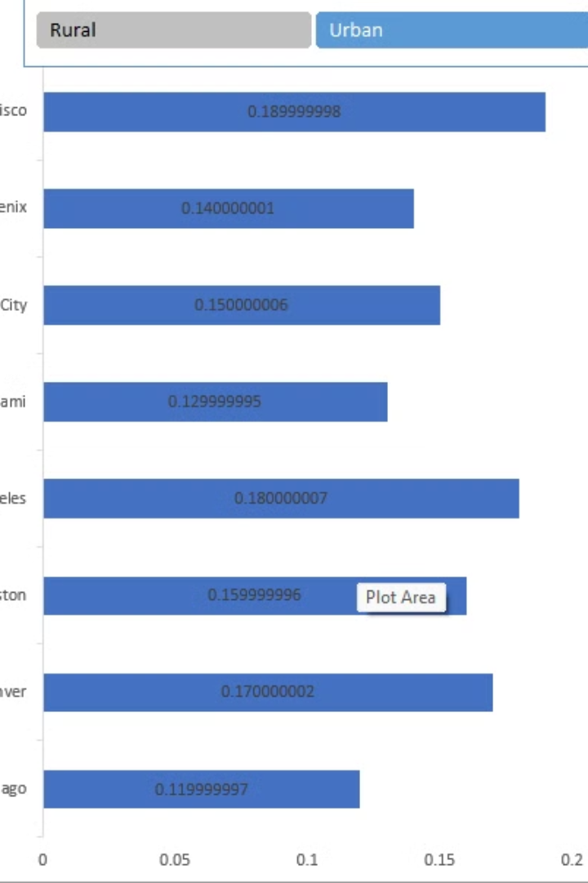
Data Analysis: Uncovering Insights
Metric
Insight
Renewable energy penetration
Regions with higher renewable energy adoption exhibit stronger economic growth and lower carbon emissions.
Energy access disparities
Rural and marginalized communities experience the most significant energy access challenges.

Slide 7
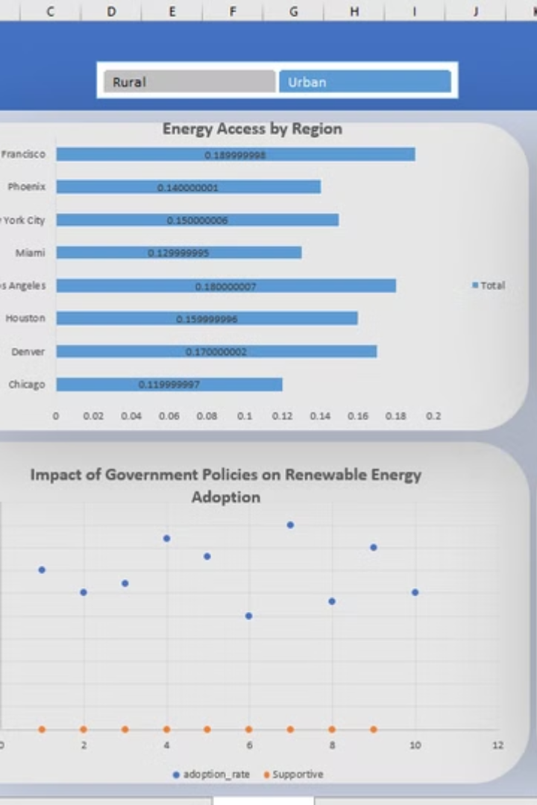
Excel Dashboard: Visualizing the Data
Interactive Maps
Visualizing energy access and renewable energy distribution across different regions.
Trend Analysis
Tracking the evolution of energy consumption patterns and renewable energy growth over time.
Comparative Analysis
Comparing energy access and renewable energy performance across different countries and regions.

Slide 8

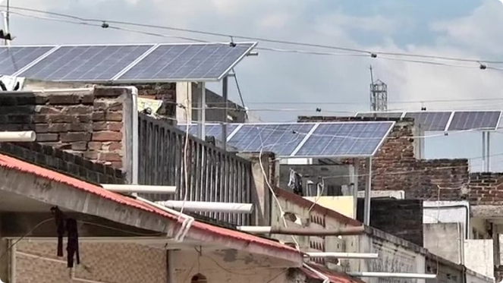



Proposed Solutions: A Pathway to Sustainable Energy
Targeted Investments
Prioritizing investments in renewable energy infrastructure and off-grid solutions in underserved areas.
Policy Reform
Creating supportive policies and regulations to promote renewable energy adoption and reduce barriers to investment.
Community Engagement
Empowering local communities to participate in renewable energy initiatives and promote sustainable energy practices.

Slide 9





Project Impact: Driving Sustainable Development
Increased Energy Access
Expanding access to electricity for millions, improving livelihoods and unlocking economic potential.
Reduced Carbon Emissions
Mitigating climate change by reducing reliance on fossil fuels and promoting clean energy solutions.
Social Equity
Bridging energy access disparities and promoting social equity by providing affordable and reliable energy for all.

Slide 10


Conclusion: A Call to Action
Our data-driven approach provides a roadmap for achieving SDG 7, fostering sustainable energy development and driving positive social and economic impact. We invite your partnership in accelerating this journey towards a brighter and more equitable energy future.

